Slide 1

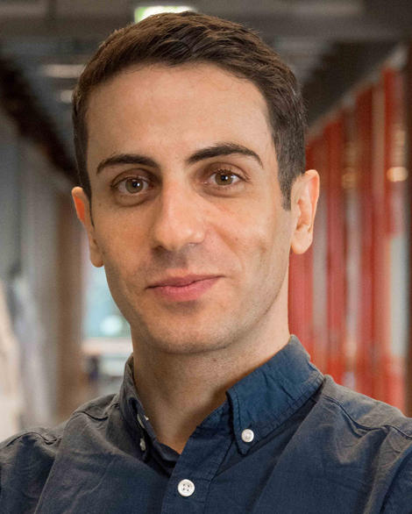
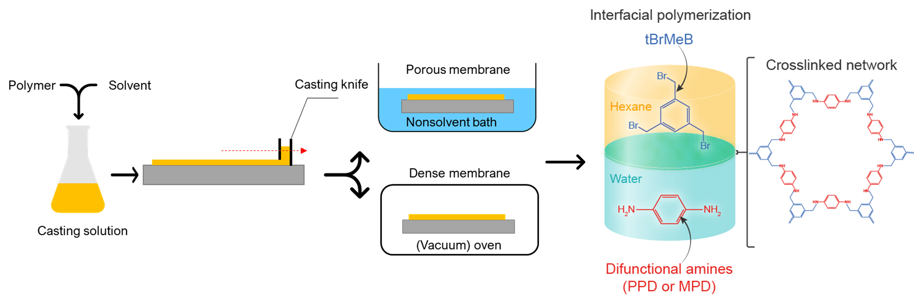
Akbar Asadi Tashvigh | Expertise?
(Wageningen University and Research)
Poster number:
(you will receive later)
Goals / Research topics
Membranes for sustaianble chemical separation
Membranes for clean energy
Electrocatalysis
Methods and Techniques
Short description and/or Figure
Short Description and/or Figure
Synthesis of polymer membranes with various functionalities for applications in liquid separations, cation/anion exchange, fuel cell
Energy community day 3rd April 2025, Eenhoorn Meeting Center Amersfoort

